Slide 1
Hotel Revenue & Booking Analytics Dashboard
Individual Excel Project
Presented by: Meera Jose
Notes:
Introduce yourself, the project title, and explain that the goal was to create an interactive hotel analytics dashboard using Excel.

Slide 2
Project Objective
• Analyze reservation and guest data.
• Monitor Revenue, ADR, Reservations and Satisfaction.
• Provide decision-support through interactive dashboards.
• Demonstrate advanced Excel concepts.
Notes:
Explain the business problem and how the dashboard helps hotel management make informed decisions.

Slide 3
Excel Features Used
Pivot Tables & Charts
Slicers & Timeline
Navigation Buttons
VBA Macros
Data Validation
Dependent Drop-down
INDEX + MATCH
SUMPRODUCT
Conditional Formatting
Notes:
Briefly explain each Excel feature and why you used it.

Slide 4
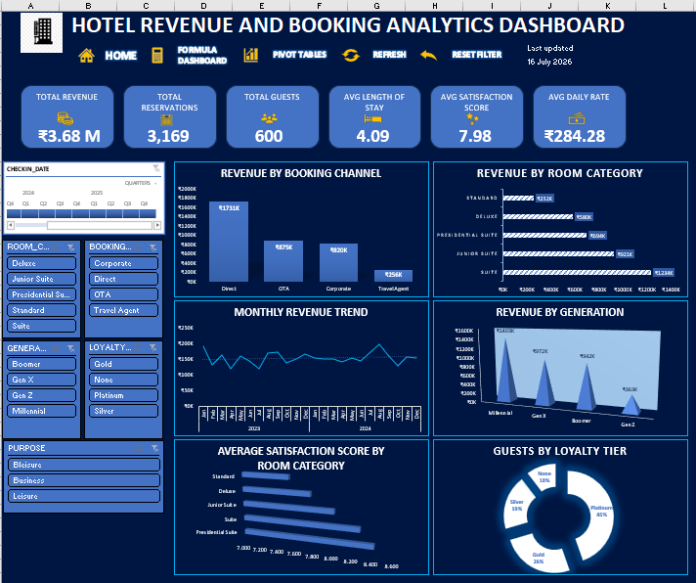
Interactive Dashboard
Interactive features:
• KPI Cards
• Revenue Analysis
• Slicers & Timeline
• Dynamic Charts
Notes:
Demonstrate slicers, timeline, KPI cards, charts, Refresh and Reset buttons. Mention how charts update dynamically.

Slide 5
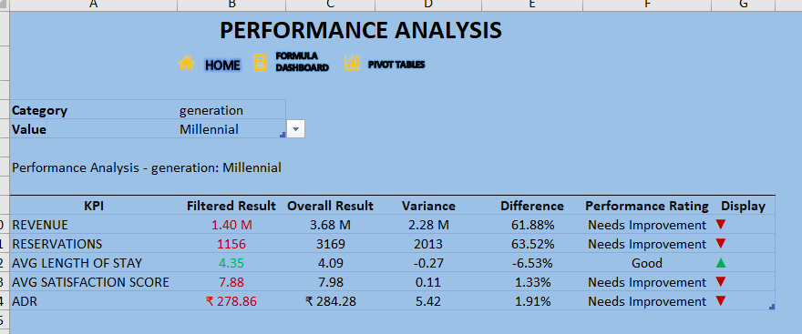
Formula Dashboard
Formula features:
• Dynamic Selection
• Formula-driven KPIs
• Conditional Formatting
• Performance Rating
Notes:
Explain Data Validation, dependent drop-downs, INDEX+MATCH, SUMPRODUCT, conditional formatting and comparison of filtered vs overall values.

Slide 6
Dashboard Functionality
• User selects Category
• Dependent Value updates
• Formulas/PivotTables recalculate
• KPIs & Charts refresh
• Management gains insights
Notes:
Walk through the workflow from user selection to business insight.

Slide 7
Business Recommendations
Increase direct bookings.
Promote premium room categories.
Improve low-rated room categories.
Strengthen loyalty programme.
Use dynamic pricing to improve ADR.
Target high-value customers.
Notes:
Relate recommendations to the charts and KPIs shown in your dashboard.

Slide 8
Key Learnings
• Built executive-style dashboards.
• Applied advanced formulas.
• Used PivotTables, Slicers and VBA.
• Improved business reporting skills.
Notes:
Summarize your technical and analytical learning outcomes.

Slide 9
Thank You
Notes:
Thank the audience and invite questions.

